Slide 1
Data acquisition & Data wrangling

Slide 2
Data Acquisition
Data Acquisition refers to the process of gathering and collecting data from various sources.
This can include databases, files, external APIs, web scraping, and many other data streams.
The data collected can be structured, semi-structured, or unstructured.

Slide 3
Data Wrangling
Data Wrangling is the process of transforming and preparing raw data into a more usable format for analysis.
This involves cleaning, structuring, and enriching the data to make it more accessible and meaningful.
Data Wrangling is a crucial step in the data analytics workflow, as it ensures that the data is accurate, complete, and in a suitable format for analysis.

Slide 4
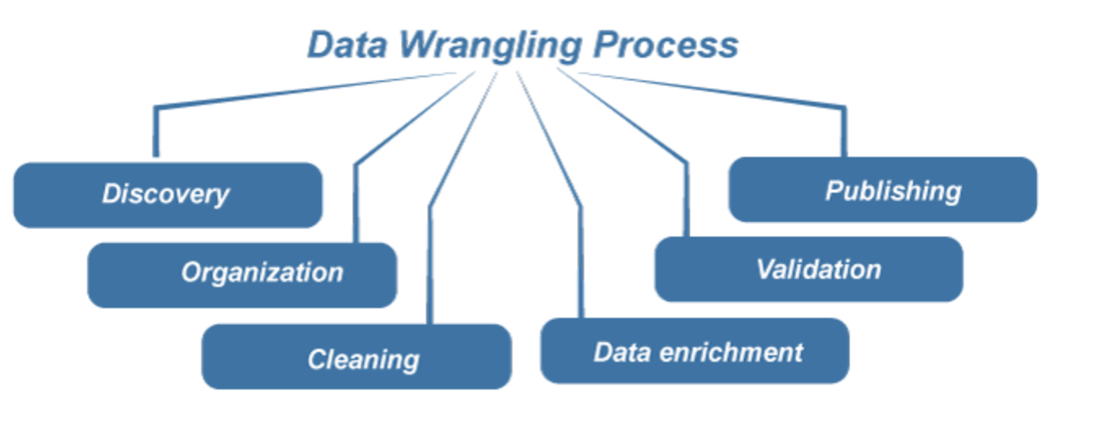
Data Wrangling Process

Slide 5
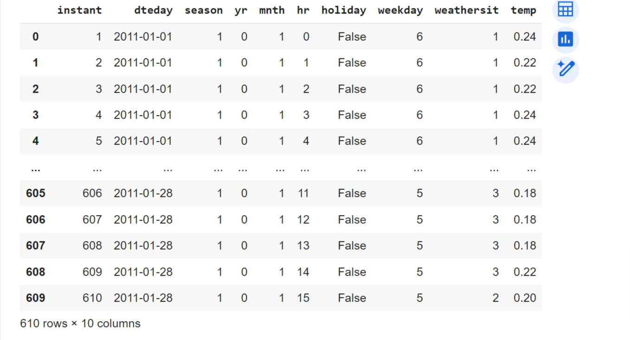
Some Methods of data cleaning
To Load data : dataset_1=pd.read_excel('/content/drive/MyDrive/Internship_Project2/dataset_1.xlsx')
Output :

Slide 6
unique() : This will print the unique values of the column.
drop(): This will remove the column from the dataset.
dtypes : this will show the datatypes.
duplicated(): this will show the duplicate value in the dataset.
isnull().sum(): This will show null values in the dataset .
Shape: this will show the shape of the data .
describe(): this will describe the data like (count ,mean,std , min , percentile, max).
pd.merge(dataset_1,dataset_2,on='instant',how='inner') : this will merge the dataset .
astype(int): it is used to convert non integer column to int .

Slide 7
mean(): it is used to find mean of the column .
median(): it is used to find median of the column .
pd.concat(df1,df2): it is used to concat two or more data .
fillna(): it is used to fill nul value by mean or median.
skew(): it is used to calculate the skewness of a dataset.
corr(): it is used to calculate the correlation coefficient between two variables in a DataFrame.
IQR: The Interquartile Range (IQR) is a measure of statistical dispersion that can be calculated as the difference between the 75th percentile (Q3) and the 25th percentile (Q1) of a dataset.
IQR= Q3-Q1

Slide 8
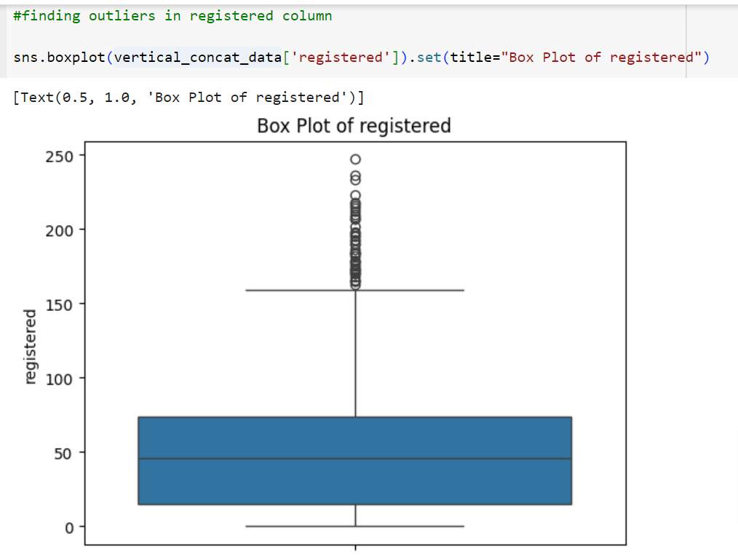
ax.boxplot(data): boxplot is used to check outliers .

Slide 9
Thank You

